Slide 1
2023 VSSA Orientation
Light Hall 202
June 5, 2023

Slide 2
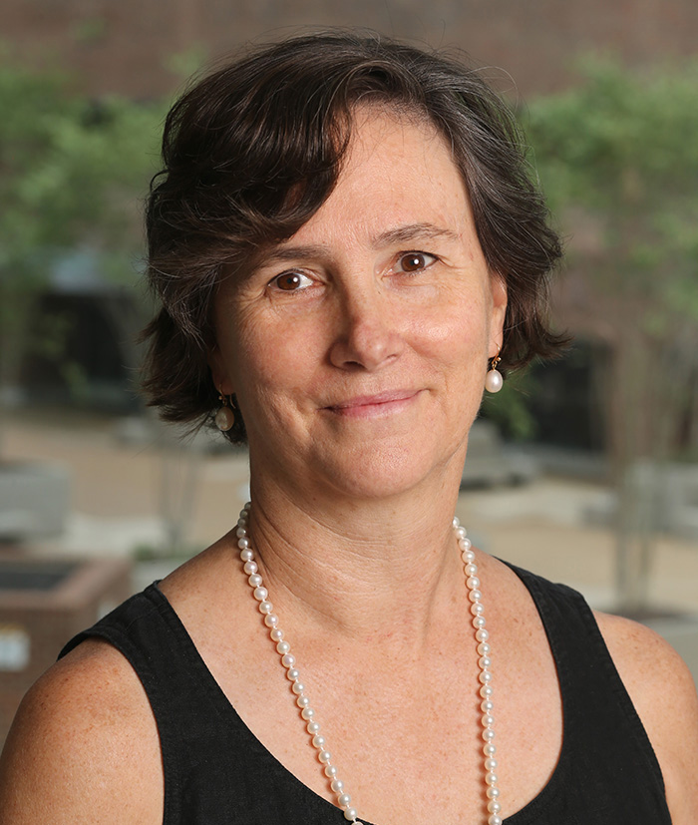
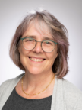
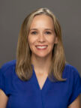
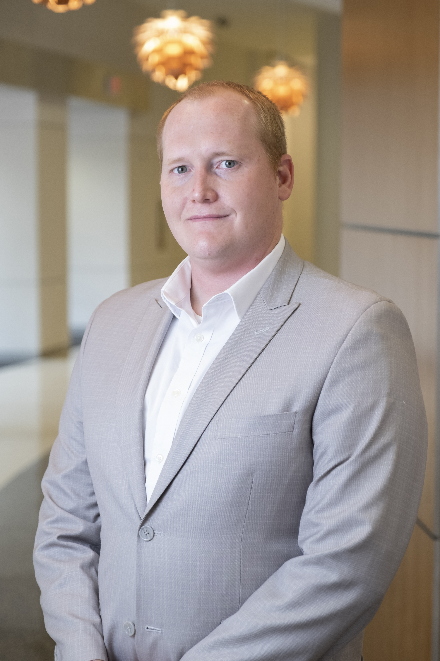
Your VSSA Team
Stephanie Richards, Ph.D.
Director
Angel Gaither,
Program Manager
Kathy Gould, Ph.D.
Senior Associate Dean for Biomedical Research Education and Training
(BRET)
RC Stabile, Ed.D.
Associate Director of Well-being
Aaron Howard
Program Manager
Light Hall 340 Suite

Slide 3
What is the VSSA?
AHA-SURE
ASPIRNAUT
BP-ENDURE
Beckman Scholar
CHEM-BIO REU
VBISP
UCRIP
Leadership Alliance
MSTP
LGBTQ+ Health
PAECER
VDSRP (Diabetes)
V-SURE
VVC

Slide 4
Today’s Schedule
RLH 202 | 1:00-1:30 pm 1:30-1:45 pm 15 min break 2:00 pm-3:30 pm 15 min break 3:45 - 4:30 pm 4:30 -5:00 pm | Intro: VSSA team Radiation Safety: Karl Witte, Biosafety: Robin Trundy and Kyle Becker Chemical Safety: Mark Bogard Sexual Harassment: Project Safe Center, Cara Tuttle Bell

Slide 5
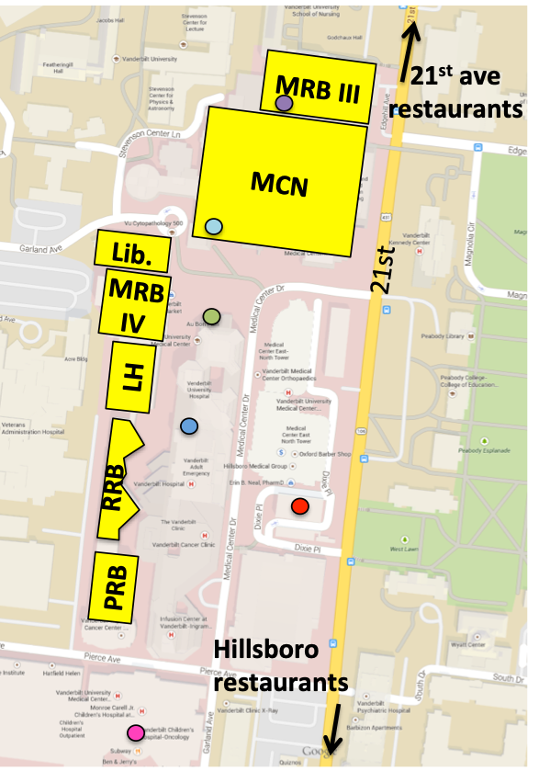
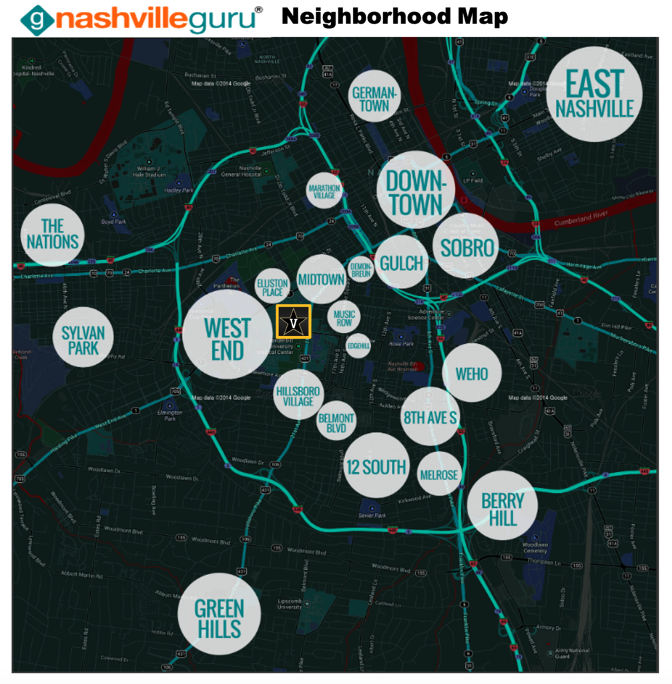
VSSA Handbook
https://medschool.vanderbilt.edu/vssa/2021-in-person-vssa/
Password: VSSAStudent
Important contact info
Living in Lewis House and The Chaffins
Stuff to do nearby and around town

Slide 6
Mail and Packages
Aaron Howard
Your name (You must list your name, or we don’t know who to give the package to)
340 Light Hall
2215 Garland Avenue
Nashville, TN 37232

Slide 7
Summer Schedule
https://medschool.vanderbilt.edu/vssa/calendar
Password: VSSAStudent
Responsible Conduct of Research (RCR): Wednesday June 7th @ 11am
Schedule – online and in the weekly newsletter
Mondays @ 12 noon -1pm
Pizza/salad lunch, please sign up. Bring your own water bottle!
Wednesdays @ 11am – 12N
End of Summer Presentations TBD

Slide 8
Summer Schedule
Monday June 12 | RLH 202 | 12N - 1pm | Faculty Talk: Dr. Steven Townsend | All Roads lead to Rome - Sourcing Inspiration as a University Professor
Wednesday June 14 | RLH 214 | 11am - 12N | Professional Development: Dr. Steph Richards | How to Read a Scientific Paper

Slide 9
Social Activities & Sign Up
RC Stabile, Ed.D.
Associate Director of Well-being

Slide 10
Tips for a successful summer
In the lab:
Use the mentor/mentee form to clarify expectations
Understand your project
Be communicative
Ask questions!
Share your ideas
Be organized
Be a courteous lab mate
Letter of recommendation

Slide 11
Tips for a successful summer
Outside the lab:
Be courteous and professional to all
Be responsible and courteous in your apartment
Be safe
Have fun ~
Remember that science is a
small world
If you have problems or concerns, contact your director
or Steph at stephanie.richards@Vanderbilt.edu

Slide 12
VSSA Survey & Evaluation
We strive to make each year a productive and fun experience
Initial program survey,
Survey at the end of the program
Follow-up survey, in 1 year

Slide 13
Lou De Felice Summer Student Travel Award
These awards aim to increase diversity and inclusion in the biomedical research community. Specifically, these awards are for students and their faculty mentor to attend either the SACNAS (Society for Advancement of Chicanos and Native Americans in Science) or ABRCMS (Annual Biomedical Research Conference for Minority Students) research conference this upcoming fall.
All current VSSA students (including independent members) are invited to apply. The following materials are required, due by Friday July 28:
An unofficial or official transcript
One letter of recommendation (emailed from the letter writerto Felysha.jenkins@Vanderbilt.Edu by
Friday, July 28th)
A Statement of Purpose detailing the following:
Your research interests and goals
Your career goals
How attending either SACNAS or ABRCMS will contribute to your training
How you contribute to diversity in the biomedical research community

Slide 14
Vanderbilt Graduate programs
MSTP (M.D./Ph.D.)
https://medschool.vanderbilt.edu/mstp/
M.D.
https://medschool.vanderbilt.edu/md-admissions/
Graduate programs
Ph.D. & Masters
Biomedical Engineering: http://engineering.vanderbilt.edu/bme/GraduateProgram/
Computer Science: http://engineering.vanderbilt.edu/eecs/Graduate/Programs.php
Ph.D.
IGP: https://medschool.vanderbilt.edu/igp/
QCB: https://medschool.vanderbilt.edu/qcb/
Chemistry: http://www.vanderbilt.edu/chemistry/graduate.php

Slide 15
Questions?
Contact:
Steph: Stephanie.Richards@vanderbilt.edu
Angel: angel.d.gaither@vanderbilt.edu
RC: rc.stabile@vanderbilt.edu
Aaron: aaron.w.howard@vanderbilt.edu

