Slide 1
Wednesday June 14 Seminar

Slide 3
Portland Maine to Lewiston Maine
To Boston Massachusetts
To Burlington Vermont
To Boston Massachusetts
To Brunswick Maine….

Slide 5
Be Brave, Not Perfect

Slide 6
How to Read a Scientific Paper
Google:
Journal of Biological Chemistry TRSM2 2023

Slide 7
Primary Literature vs Review Article
Original data done by that group
Look for data figures
Look for a Methods section
Look for the sections of a research article
A summary of the work on a topic from many groups
No original data
No Methods section
Often lots of diagrams vs data figures

Slide 8
Understand the Structure of a Primary Literature Article
Title - Key terms, the system/molecules/result
Abstract – A summary of the paper
Introduction – Background, current state of knowledge, the question being asked
Methods – methods used for experiments
Results – what was found
Discussion – How these results fit into the current state of knowledge, how these results advance knowledge, and what the result means
Supplemental Materials
References

Slide 9
Understand Your Purpose
Background knowledge?
Understanding a method?
Using a particular method?
Replicating a result?

Slide 10
You will read a paper MULTIPLE TIMES.
You will NOT read it straight from beginning to end.
Skim the article. Get a sense of the terms, the structure. Read the abstract, the end of the intro, the end of the discussion
Reread the abstract. Read the Introduction. Read the Discussion, focusing on the beginning and the end.
Note and look up terms you don’t know
Go through the Results section, highlighting the Figures; look at the subheadings.
Look at the Methods, focusing only on the subheadings.
Look up methods that are not familiar to you, and stay away from the nitty gritty details
Reread the abstract, focusing on the results statements, then read each Results section:
Figure 1 text with Figure 1 images
Figure 2 text with Figure 2 images, etc.
You may be looking at Methods at this time too
When you finish the results section, then read the entire Discussion.
Go back and now read the entire paper, focusing on the reasons for doing various experiments and the findings for each, and then the conclusions. Pay attention to the flow and the focus.
Make note of any questions you have AS YOU READ!

Slide 11
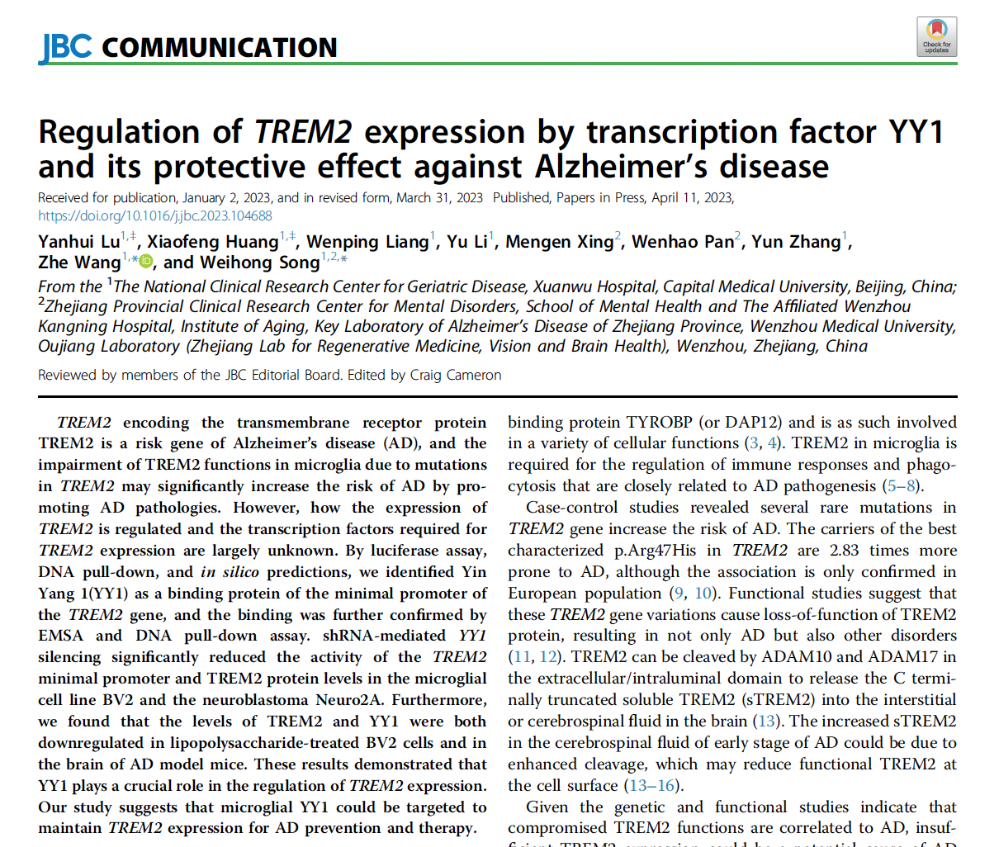

Slide 12
TREM2 is expressed and that expression is regulated
Expression regulated by YY1, which is a transcription factor
Regulating that expression has a protective effect against Alzheimer’s
What is TREM2?
How does YY1 regulate TREM2 expression?
How do they measure a protective effect?

Slide 13
Abstract
TREM2 encoding the transmembrane receptor protein
TREM2 is a risk gene of Alzheimer’s disease (AD), and the
impairment of TREM2 functions in microglia due to mutations
in TREM2 may significantly increase the risk of AD by promoting
AD pathologies. However, how the expression of
TREM2 is regulated and the transcription factors required for
TREM2 expression are largely unknown. By luciferase assay,
DNA pull-down, and in silico predictions, we identified Yin
Yang 1(YY1) as a binding protein of the minimal promoter of
the TREM2 gene, and the binding was further confirmed by
EMSA and DNA pull-down assay. shRNA-mediated YY1
silencing significantly reduced the activity of the TREM2
minimal promoter and TREM2 protein levels in the microglial
cell line BV2 and the neuroblastoma Neuro2A. Furthermore,
we found that the levels of TREM2 and YY1 were both
downregulated in lipopolysaccharide-treated BV2 cells and in
the brain of AD model mice. These results demonstrated that
YY1 plays a crucial role in the regulation of TREM2 expression.
Our study suggests that microglial YY1 could be targeted to
maintain TREM2 expression for AD prevention and therapy.

Slide 14
TREM2 encoding the transmembrane receptor protein
TREM2 is a risk gene of Alzheimer’s disease (AD), and the
impairment of TREM2 functions in microglia due to mutations
in TREM2 may significantly increase the risk of AD by promoting
AD pathologies. However, how the expression of
TREM2 is regulated and the transcription factors required for
TREM2 expression are largely unknown. By luciferase assay,
DNA pull-down, and in silico predictions, we identified Yin
Yang 1(YY1) as a binding protein of the minimal promoter of
the TREM2 gene, and the binding was further confirmed by
EMSA and DNA pull-down assay. shRNA-mediated YY1
silencing significantly reduced the activity of the TREM2
minimal promoter and TREM2 protein levels in the microglial
cell line BV2 and the neuroblastoma Neuro2A. Furthermore,
we found that the levels of TREM2 and YY1 were both
downregulated in lipopolysaccharide-treated BV2 cells and in
the brain of AD model mice. These results demonstrated that
YY1 plays a crucial role in the regulation of TREM2 expression.
Our study suggests that microglial YY1 could be targeted to
maintain TREM2 expression for AD prevention and therapy.
Background info

Slide 15
TREM2 encoding the transmembrane receptor protein
TREM2 is a risk gene of Alzheimer’s disease (AD), and the
impairment of TREM2 functions in microglia due to mutations
in TREM2 may significantly increase the risk of AD by promoting
AD pathologies. However, how the expression of
TREM2 is regulated and the transcription factors required for
TREM2 expression are largely unknown. By luciferase assay,
DNA pull-down, and in silico predictions, we identified Yin
Yang 1(YY1) as a binding protein of the minimal promoter of
the TREM2 gene, and the binding was further confirmed by
EMSA and DNA pull-down assay. shRNA-mediated YY1
silencing significantly reduced the activity of the TREM2
minimal promoter and TREM2 protein levels in the microglial
cell line BV2 and the neuroblastoma Neuro2A. Furthermore,
we found that the levels of TREM2 and YY1 were both
downregulated in lipopolysaccharide-treated BV2 cells and in
the brain of AD model mice. These results demonstrated that
YY1 plays a crucial role in the regulation of TREM2 expression.
Our study suggests that microglial YY1 could be targeted to
maintain TREM2 expression for AD prevention and therapy.
Background info
The Question, what is not known

Slide 16
TREM2 encoding the transmembrane receptor protein
TREM2 is a risk gene of Alzheimer’s disease (AD), and the
impairment of TREM2 functions in microglia due to mutations
in TREM2 may significantly increase the risk of AD by promoting
AD pathologies. However, how the expression of
TREM2 is regulated and the transcription factors required for
TREM2 expression are largely unknown. By luciferase assay,
DNA pull-down, and in silico predictions, we identified Yin
Yang 1(YY1) as a binding protein of the minimal promoter of
the TREM2 gene, and the binding was further confirmed by
EMSA and DNA pull-down assay. shRNA-mediated YY1
silencing significantly reduced the activity of the TREM2
minimal promoter and TREM2 protein levels in the microglial
cell line BV2 and the neuroblastoma Neuro2A. Furthermore,
we found that the levels of TREM2 and YY1 were both
downregulated in lipopolysaccharide-treated BV2 cells and in
the brain of AD model mice. These results demonstrated that
YY1 plays a crucial role in the regulation of TREM2 expression.
Our study suggests that microglial YY1 could be targeted to
maintain TREM2 expression for AD prevention and therapy.
Background info
The Question, what is not known
Methods

Slide 17
TREM2 encoding the transmembrane receptor protein
TREM2 is a risk gene of Alzheimer’s disease (AD), and the
impairment of TREM2 functions in microglia due to mutations
in TREM2 may significantly increase the risk of AD by promoting
AD pathologies. However, how the expression of
TREM2 is regulated and the transcription factors required for
TREM2 expression are largely unknown. By luciferase assay,
DNA pull-down, and in silico predictions, we identified Yin
Yang 1(YY1) as a binding protein of the minimal promoter of
the TREM2 gene, and the binding was further confirmed by
EMSA and DNA pull-down assay. shRNA-mediated YY1
silencing significantly reduced the activity of the TREM2
minimal promoter and TREM2 protein levels in the microglial
cell line BV2 and the neuroblastoma Neuro2A. Furthermore,
we found that the levels of TREM2 and YY1 were both
downregulated in lipopolysaccharide-treated BV2 cells and in
the brain of AD model mice. These results demonstrated that
YY1 plays a crucial role in the regulation of TREM2 expression.
Our study suggests that microglial YY1 could be targeted to
maintain TREM2 expression for AD prevention and therapy.
Background info
The Question, what is not known
Methods
Results

Slide 18
TREM2 encoding the transmembrane receptor protein
TREM2 is a risk gene of Alzheimer’s disease (AD), and the
impairment of TREM2 functions in microglia due to mutations
in TREM2 may significantly increase the risk of AD by promoting
AD pathologies. However, how the expression of
TREM2 is regulated and the transcription factors required for
TREM2 expression are largely unknown. By luciferase assay,
DNA pull-down, and in silico predictions, we identified Yin
Yang 1(YY1) as a binding protein of the minimal promoter of
the TREM2 gene, and the binding was further confirmed by
EMSA and DNA pull-down assay. shRNA-mediated YY1
silencing significantly reduced the activity of the TREM2
minimal promoter and TREM2 protein levels in the microglial
cell line BV2 and the neuroblastoma Neuro2A. Furthermore,
we found that the levels of TREM2 and YY1 were both
downregulated in lipopolysaccharide-treated BV2 cells and in
the brain of AD model mice. These results demonstrated that
YY1 plays a crucial role in the regulation of TREM2 expression.
Our study suggests that microglial YY1 could be targeted to
maintain TREM2 expression for AD prevention and therapy.
Background info
The Question, or what is not known yet
Methods
Results
Conclusions and implications

Slide 19
Introduction
Remember this is a persuasive essay
Will provide background
Knowledge of area to this point in time
Broad statements
More specific details
Specific question being asked

Slide 20
binding protein TYROBP (or DAP12) and is as such involved
in a variety of cellular functions (3, 4). TREM2 in microglia is
required for the regulation of immune responses and phagocytosis
that are closely related to AD pathogenesis (5–8).
Case-control studies revealed several rare mutations in
TREM2 gene increase the risk of AD. The carriers of the best
characterized p.Arg47His in TREM2 are 2.83 times more
prone to AD, although the association is only confirmed in
European population (9, 10). Functional studies suggest that
these TREM2 gene variations cause loss-of-function of TREM2
protein, resulting in not only AD but also other disorders
(11, 12). TREM2 can be cleaved by ADAM10 and ADAM17 in
the extracellular/intraluminal domain to release the C terminally
truncated soluble TREM2 (sTREM2) into the interstitial
or cerebrospinal fluid in the brain (13). The increased sTREM2
in the cerebrospinal fluid of early stage of AD could be due to
enhanced cleavage, which may reduce functional TREM2 at
the cell surface (13–16).
Given the genetic and functional studies indicate that
compromised TREM2 functions are correlated to AD, insufficient
TREM2 expression could be a potential cause of AD
(17). In vitro studies in microglial cells demonstrated that the
expression of TREM2 is decreased by proinflammatory agents
such as TNFα, IL1β, IFNγ, and lipopolysaccharide (LPS)
(18, 19). However, how TREM2 expression is regulated,
especially in the context of AD, remains elusive.
In this study, we identified Yin Yang 1 (YY1) as a transcription
factor required for TREM2 expression. An evolutionarily
conserved YY1 response element close to the
transcription starting site (TSS) of TREM2 is indispensable for
YY1-mediated TREM2 expression. In microglia cell challenged
with LPS and in brains of AD model mice, both TREM2 and
YY1 were significantly decreased. Therefore, microglial YY1
could be targeted to maintain TREM2 expression for AD
prevention and therapy.
Introduction
Connecting AD and TREM2 mutations
Low TREM2 levels may cause AD
Alzheimer’s disease (AD) is the most common neurode-
generative disease leading to dementia in the elderly. The
extracellular neuritic plaque with the amyloid protein (Aβ) as
the major component and intracellular fibrillary tangle
formed by the aggregation of hyperphosphorylated tau protein
are the characteristic neuropathologies of AD (1). While
how neuritic plaque and fibrillary tangle deposit in the brain
of AD patients is not clear, impaired clearance of toxic
components by the innate immune cells could contribute to
the pathology (2).
Triggering receptor expressed on myeloid cells (TREM2) is
a type I transmembrane receptor mainly expressed in myeloid
lineage including microglia in the brain. Upon its binding with
extracellular ligands on the plasma membrane, TREM2 initiates
downstream signaling cascades through its cytoplasmic
Info on AD
How TREM2 levels regulated unknown – this is the purpose of the study!
Info on TREM2

Slide 21
In this study, we identified Yin Yang 1 (YY1) as a transcription
factor required for TREM2 expression. An evolutionarily
conserved YY1 response element close to the
transcription starting site (TSS) of TREM2 is indispensable for
YY1-mediated TREM2 expression. In microglia cell challenged
with LPS and in brains of AD model mice, both TREM2 and
YY1 were significantly decreased. Therefore, microglial YY1
could be targeted to maintain TREM2 expression for AD
prevention and therapy.

Slide 22
Discussion: What the Results Mean
Will embed this new information in the context of what was known
Articulates the answer to the question posed in the introduction
Explains what the results mean
Conclusions from these results
More specific details,
In the context of the literature
Broad statements,
Big picture implications

Slide 23
fragments pTREM2-E (0 −33) and G (−983 −303) in PGL3-
Basic displayed even lower promoter activity than the empty
PGL3-Basic vector. One possible explanation is that these fragments
replaced the multiple cloning sites of PGL3-Basic that may
have a weak promoter activity. If this is the case, the promoter
activity of −370 +33 could have been under estimated.
YY1 is ubiquitously expressed in mammalian cells and
serves as both transcription activator and repressor depending
on its modifications, cofactors, chromatin structures, and
target genes (29, 30). Some studies suggested that YY1 in
neurons may increase Aβ by regulating the expression of
proteins directly and indirectly involved in Aβ production
(31–33). Biopsy examinations indicated that in the hippocampus
and temporal cortex of AD patients, YY1 decreases
and the proteolytic fragments of YY1 increases. Moreover, YY1
was also found to be reduced in the brains of patients with
other neurodegenerative disease (34). We found that YY1 in
BV2 is decreased by LPS, a condition to simulate neuroinflammation
that is common for almost all neurodegenerative
diseases. However, LPS was shown to increase YY1 activity in
B cell in the periphery (35). Our results suggested that YY1
may directly promote TREM2 expression in microglia, which
in turn enhances the clearance of Aβ, suppresses the immune
responses, and maintains the cell homeostasis of microglia.
Interestingly, YY1 was also reported to indirectly upregulate
TREM2 through miRNA (36). Thus, to maintain microglial
TREM2 expression by enhancing YY1 activity could be a potential
strategy for AD prevention and diagnosis.
Discussion
Deficiency in TREM2 significantly increases the risk of AD.
In microglia, the major cell type in the brain to express
TREM2, TREM2 participates in multiple cellular functions
such as mediating the phagocytosis of Aβ, suppressing the
inflammatory, and orchestrating lipid metabolism (23). All of
these functions of microglia are compromised in AD (4). The
mutations/SNPs in TREM2 correlated to AD may blunt some
of these functions and as such increase the risk of AD (24–26).
In nonmutation/SNP carriers, TREM2 may be involved in AD
pathogenesis through altered expression (5, 27), and the
decreased TREM2 expression compromises the functions of
TREM2 (28). However, how TREM2 expression is regulated
and the transcription factors required for TREM2 expression
are largely unknown.
To identify the minimal promoter region of TREM2 and the
transcription factors necessary for TREM2 expression, we
generated a series of fragments upstream TSS of TREM2 gene. It
was interesting to note that although the longest fragment
(−983 +33) we tested showed little promoter activity, when it
was truncated down to −370 +33, the promoter activity spiked
up. Further truncation of −370 +33 to −118 +33 abolished
promoter activity. Together, these data indicated that there could
be repressing cis-element between −580 −370 and activating
cis-element between −370 −118. We also noticed that the
Resetting the stage here
Info on YY1, not in intro
What they found
What they did
Related info in the literature
What their results mean, their conclusions
What they found

Slide 24
Given the genetic and functional studies indicate that
compromised TREM2 functions are correlated to AD, insufficient TREM2 expression could be a potential cause of AD (17). In vitro studies in microglial cells demonstrated that the expression of TREM2 is decreased by proinflammatory agents such as TNFα, IL1β, IFNγ, and lipopolysaccharide (LPS) (18, 19). However, how TREM2 expression is regulated, especially in the context of AD, remains elusive.
From the Introduction
We found that YY1 in BV2 is decreased by LPS, a condition to simulate neuroinflammation that is common for almost all neurodegenerative diseases. However, LPS was shown to increase YY1 activity in B cell in the periphery (35). Our results suggested that YY1 may directly promote TREM2 expression in microglia, which in turn enhances the clearance of Aβ, suppresses the immune responses, and maintains the cell homeostasis of microglia.
Interestingly, YY1 was also reported to indirectly upregulate
TREM2 through miRNA (36). Thus, to maintain microglial
TREM2 expression by enhancing YY1 activity could be a potential strategy for AD prevention and diagnosis.
From the Discussion –
The “Edge of the World” has moved,
YY1 has been added to this system/response

Slide 25
Results – What they found
Text will describe the results – the words
Figures will show the results – the images
You want to read them together
Pay attention to subheadings!
Look for topic sentences (what we’re doing and why)
Look for results statements (we found/the data show…)
The results often flow from one to another, to tell a story
Key results are often near the end. Results near the beginning often define/set up the system.

Slide 26
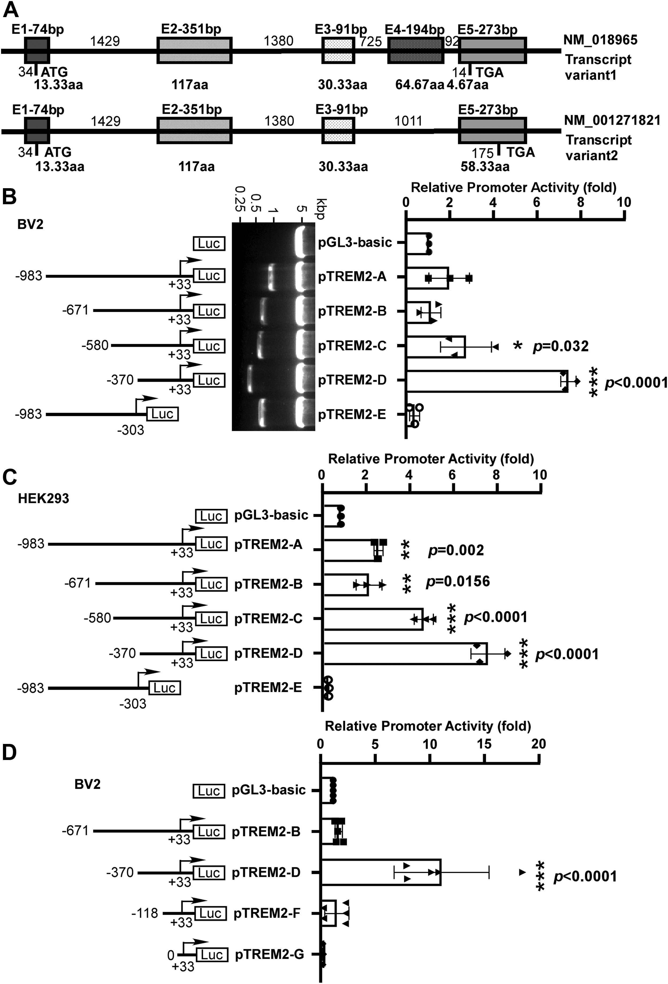
Identification of the minimal active region in TREM2 promoter
Human TREM2 gene transcript can be spliced into two
variants: the variant 1 is 693 bp in length and consists of five
exons, whereas variant 2 is 660 bp in length and lacks exon 4
with larger exon 5. The two variants differ only in the 3’ ends
and share the identical TSS. To investigate the transcriptional
activity of the human TREM2 gene promoter, we extracted
human genomic DNA and cloned a 983-bp fragment upstream
the TSS (site 0, and the start codon ATG is +34–+36) (Fig. 1A).
This fragment, and a series of 5’ deletion fragments, were
cloned into pGL3-Basic vector for luciferase reporter assay. As
in the brain, TREM2 is highly expressed in microglia, we first
transfected the plasmids into the microglial cell line BV2 and
cotransfected the plasmid pCMV-RLuc to express Renilla
luciferase under the strong ubiquitous promoter CMV as an
internal control (Fig. 1B). The plasmid pTREM2-A and
pTREM2-B, containing −983 +33 and −671 +33, respectively,
displayed a similar promoter activity compared to pGL3-
Basic. The promoter activity of pTREM2-C containing
−580 +33 had slight increase by 2.679 ± 0.452 folds compared
with vector. Further 5’ truncation down to −370 +33
(pTREM2-D) significantly elevated the promoter activity by
6.391 ± 1.167 folds compared with pGL3-Basic. Another
fragment −983 −303 (pTREM2-E) showed nearly zero promoter
activity and the luciferase expression under this fragment
is even lower than that in PGL3-Basic. Similar difference
in the promoter activities of these fragments were also found in
human embryonic kidney 293 (HEK293) cells (Fig. 1C). It appears
that in the −983 +33 region, there are both positive and
negative regulatory elements, with the latter
within −580 −370 bp region.
To further narrow down the core promoter region, additional
5’ deletion fragments −118 +33 and 0 +33 were cloned into
PGL3-Basic to generate pTREM2-F and pTREM2-G. Both
pTREM2-F and pTREM2-G had little promoter activity. These
data suggested that there is a strong cis-acting element between
−370 and −118 that spiked luciferase expression and
could be crucial for TREM2 expression (Fig. 1D).

Slide 27
Identification of the minimal active region in TREM2 promoter
This fragment, and a series of 5’ deletion fragments, were cloned into pGL3-Basic vector for luciferase reporter assay. As in the brain, TREM2 is highly expressed in microglia, we first transfected the plasmids into the microglial cell line BV2 and cotransfected the plasmid pCMV-RLuc to express Renilla luciferase under the strong ubiquitous promoter CMV as an internal control (Fig. 1B). The plasmid pTREM2-A and pTREM2-B, containing −983 +33 and −671 +33, respectively, displayed a similar promoter activity compared to pGL3-Basic. The promoter activity of pTREM2-C containing −580 +33 had slight increase by 2.679 ± 0.452 folds compared with vector. Further 5’ truncation down to −370 +33 (pTREM2-D) significantly elevated the promoter activity by 6.391 ± 1.167 folds compared with pGL3-Basic. Another fragment −983 −303 (pTREM2-E) showed nearly zero promoter activity and the luciferase expression under this fragment is even lower than that in PGL3-Basic.
B, schematic illustration of human TREM2 promoter deletion constructs in pGL3-Basic vector. The arrow represents the direction of transcription and the number demonstrates the start and ending point of each construct insert relative to the transcription start site. TREM2 promoter deletion constructs were veriﬁed by restriction enzyme digestion, and the digested products were analyzed on 1.2 % agarose gel. The size of pGL3-Basic vector is 4.8 kb and inserts range from 337 bp to 1016 bp. The inserts were further conﬁrmed by sequencing. The series of deletion constructs were cotransfected with pCMV-RLuc into BV2 cells. The cell lysates were harvested 24 h after transfection, and the luciferase activity was measured with a luminometer. The TREM2 promoter luciferase activity was normalized by pCMV-Luc luciferase activity for transfection efﬁciency and expressed in folds in comparison with the luciferase activity of pGL3-Basic vector.

Slide 28
Identification of the minimal active region in TREM2 promoter
This fragment, and a series of 5’ deletion fragments, were cloned into pGL3-Basic vector for luciferase reporter assay. As in the brain, TREM2 is highly expressed in microglia, we first transfected the plasmids into the microglial cell line BV2 and cotransfected the plasmid pCMV-RLuc to express Renilla luciferase under the strong ubiquitous promoter CMV as an internal control (Fig. 1B). The plasmid pTREM2-A and pTREM2-B, containing −983 +33 and −671 +33, respectively, displayed a similar promoter activity compared to pGL3-Basic. The promoter activity of pTREM2-C containing −580 +33 had slight increase by 2.679 ± 0.452 folds compared with vector. Further 5’ truncation down to −370 +33 (pTREM2-D) significantly elevated the promoter activity by 6.391 ± 1.167 folds compared with pGL3-Basic. Another fragment −983 −303 (pTREM2-E) showed nearly zero promoter activity and the luciferase expression under this fragment is even lower than that in PGL3-Basic.
B, schematic illustration of human TREM2 promoter deletion constructs in pGL3-Basic vector. The arrow represents the direction of transcription and the number demonstrates the start and ending point of each construct insert relative to the transcription start site. TREM2 promoter deletion constructs were veriﬁed by restriction enzyme digestion, and the digested products were analyzed on 1.2 % agarose gel. The size of pGL3-Basic vector is 4.8 kb and inserts range from 337 bp to 1016 bp. The inserts were further conﬁrmed by sequencing. The series of deletion constructs were cotransfected with pCMV-RLuc into BV2 cells. The cell lysates were harvested 24 h after transfection, and the luciferase activity was measured with a luminometer. The TREM2 promoter luciferase activity was normalized by pCMV-Luc luciferase activity for transfection efﬁciency and expressed in folds in comparison with the luciferase activity of pGL3-Basic vector.

Slide 29
Identification of the minimal active region in TREM2 promoter
Human TREM2 gene transcript can be spliced into two
variants: the variant 1 is 693 bp in length and consists of five
exons, whereas variant 2 is 660 bp in length and lacks exon 4
with larger exon 5. The two variants differ only in the 3’ ends
and share the identical TSS. To investigate the transcriptional
activity of the human TREM2 gene promoter, we extracted
human genomic DNA and cloned a 983-bp fragment upstream
the TSS (site 0, and the start codon ATG is +34–+36) (Fig. 1A).
This fragment, and a series of 5’ deletion fragments, were
cloned into pGL3-Basic vector for luciferase reporter assay. As
in the brain, TREM2 is highly expressed in microglia, we first
transfected the plasmids into the microglial cell line BV2 and
cotransfected the plasmid pCMV-RLuc to express Renilla
luciferase under the strong ubiquitous promoter CMV as an
internal control (Fig. 1B). The plasmid pTREM2-A and
pTREM2-B, containing −983 +33 and −671 +33, respectively,
displayed a similar promoter activity compared to pGL3-
Basic. The promoter activity of pTREM2-C containing
−580 +33 had slight increase by 2.679 ± 0.452 folds compared
with vector. Further 5’ truncation down to −370 +33
(pTREM2-D) significantly elevated the promoter activity by
6.391 ± 1.167 folds compared with pGL3-Basic. Another
fragment −983 −303 (pTREM2-E) showed nearly zero promoter
activity and the luciferase expression under this fragment
is even lower than that in PGL3-Basic. Similar difference
in the promoter activities of these fragments were also found in
human embryonic kidney 293 (HEK293) cells (Fig. 1C). It appears
that in the −983 +33 region, there are both positive and
negative regulatory elements, with the latter
within −580 −370 bp region.
To further narrow down the core promoter region, additional
5’ deletion fragments −118 +33 and 0 +33 were cloned into
PGL3-Basic to generate pTREM2-F and pTREM2-G. Both
pTREM2-F and pTREM2-G had little promoter activity. These
data suggested that there is a strong cis-acting element between
−370 and −118 that spiked luciferase expression and
could be crucial for TREM2 expression (Fig. 1D).

Slide 30
Methods: What they did
These and the figure legends give details that will allow the experiment to be replicated
Pay attention to subheadings!
For unfamiliar methods, look for videos and animations on YouTube
Do NOT get bogged down in the details
Unless you are looking for experimental details to replicate the experiment

Slide 31
Cell culture, transfection, and luciferase reporter assay
HEK293 cells and BV2 cells were purchased from the American Tissue Culture Collection and were cultured in Dulbecco’smodiﬁed Eagle’s medium containing 10% fetal bovine serum, 1 mM sodium pyruvate, 2 mM L-glutamine (servicebio) at 37ºC in a 5% CO2 and 95% air in an incubator. HEK293 cells and BV2 cells were cotransfected with 500 ng TREM2 promoter constructs and 1 ng pCMV-RLuc per well of 24-well plate with lipo8000 (Beyotime) for luciferase assay. Luciferase assay was performed according to technical manual of Dual-Luciferase Reporter Assay System (Promega). Cell lysates were harvested and lysed with 100 μl passive lysis buffer per well after 24 hours transfection. Fireﬂy luciferase activities and Renilla luciferase activities were measured sequentially by the Dual-Luciferase Reporter Assay System (Promega). The ﬁreﬂy luciferase activity was normalized with Renilla luciferase activity and represented as relative folds in comparison with pGL3-Basic vector activity. The YY1 targeting sequence of the shRNA (50 GTGGTTGAAGAGCAGATCATTTTCAA-GAGAAATGATCTGCTCTTCAACCACTTTTTT 30)was cloned into pAV-U6-shRNA-CMV-intron-GFP vector for the expression under U6 promoter.
What is transfection?
What is cotransfection?
What is a luciferase assay?

Slide 33
Supplemental Materials
Additional data, not the key info but can be helpful
Unless you are diving deep, don’t spend a lot of time here
References
These allow you to move BACK in time
Can be helpful if you are looking for more background information

Slide 34
If you are reading primarily for background info, focus on
Title
Abstract
Intro
Discussion
Read the subheadings in the Results, look for key results statements
Maybe look at the key results mentioned in the abstract
Skim the methods (maybe)
If you are reading for information about the experimental system, focus more on
Results
Methods

Slide 35
Keep an annotated bibliography
Paper citation info
A few sentences on the key info/findings
Maybe a list of methods
Lu Y, Huang X, Liang W, Li Y, Xing M, Pan W, Zhang Y, Wang Z, Song W. Regulation of TREM2 expression by transcription factor YY1 and its protective effect against Alzheimer's disease. J Biol Chem. 2023 May;299(5):104688. doi: 10.1016/j.jbc.2023.104688. Epub 2023 Apr 11. PMID: 37044212; PMCID: PMC10193014.
Identified a small region of the promoter of TREM2 that controls TREM2 expression
Found that YY1 binds to the promoter
TREM2 and YY1 were both downregulated in cultured cells when cells treated with inflammation activating compounds
TREM2 and YY1 also downregulated in mouse brain of AD model mice
Methods: cell culture, transfection, luciferase assay, DNA pulldown assay, mass spec, Electrophoretic mobility shift assay (EMSA), immunoblotting/Western blotting

