Slide 1
Monday July 17
How to Write an Abstract

Slide 2
Abstract Structure
1. Background info
The Question, or what is not known yet
2. Some sort of methodology
3. Results
4. Conclusions and implications

Slide 3
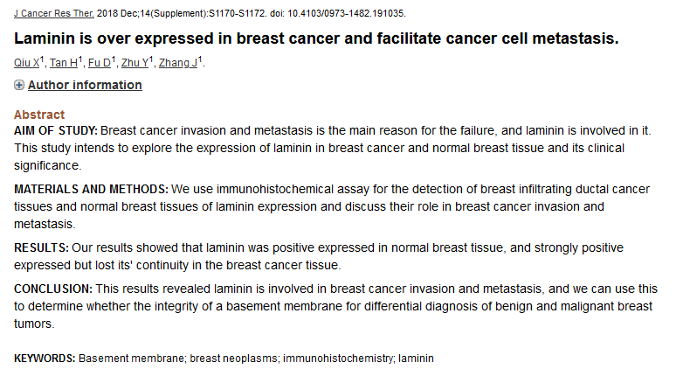

Slide 4
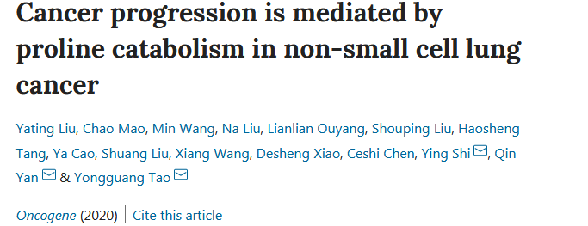
Dysregulated metabolism contributes to cancer initiation and progression, but the key drivers of these pathways are just being discovered. Here, we report a critical role for proline catabolism in non-small cell lung cancer (NSCLC). Proline dehydrogenase (PRODH) is activated to reduce proline levels by the chromatin remodeling factor lymphoid-specific helicase (LSH), an epigenetic driver of NSCLC. PRODH promotes MSCLC tumorigenesis by including epithelial to mesenchymal transition (EMT) and IKKa-dependent inflammatory genes, including CXCL1, LCN2, and IL17C. Consistently, proline addition promotes the expression of these inflammatory genes, as well as EMT, tumor cell proliferation, and migration in vitro and tumor growth in vivo, while the depletion of inhibition of PRODH blocks these phenotypes. In summary, we reveal an essential metabolic pathway amenable to targeting in NSCLC.

Slide 5
Dysregulated metabolism contributes to cancer initiation and progression, but the key drivers of these pathways are just being discovered. Here, we report a critical role for proline catabolism in non-small cell lung cancer (NSCLC). Proline dehydrogenase (PRODH) is activated to reduce proline levels by the chromatin remodeling factor lymphoid-specific helicase (LSH), an epigenetic driver of NSCLC. PRODH promotes MSCLC tumorigenesis by including epithelial to mesenchymal transition (EMT) and IKKa-dependent inflammatory genes, including CXCL1, LCN2, and IL17C. Consistently, proline addition promotes the expression of these inflammatory genes, as well as EMT, tumor cell proliferation, and migration in vitro and tumor growth in vivo, while the depletion of inhibition of PRODH blocks these phenotypes. In summary, we reveal an essential metabolic pathway amenable to targeting in NSCLC.

Slide 6
Dysregulated metabolism contributes to cancer initiation and progression, but the key drivers of these pathways are just being discovered. Here, we report a critical role for proline catabolism in non-small cell lung cancer (NSCLC). Proline dehydrogenase (PRODH) is activated to reduce proline levels by the chromatin remodeling factor lymphoid-specific helicase (LSH), an epigenetic driver of NSCLC. PRODH promotes MSCLC tumorigenesis by including epithelial to mesenchymal transition (EMT) and IKKa-dependent inflammatory genes, including CXCL1, LCN2, and IL17C. Consistently, proline addition promotes the expression of these inflammatory genes, as well as EMT, tumor cell proliferation, and migration in vitro and tumor growth in vivo, while the depletion of inhibition of PRODH blocks these phenotypes. In summary, we reveal an essential metabolic pathway amenable to targeting in NSCLC.

Slide 7
Dysregulated metabolism contributes to cancer initiation and progression, but the key drivers of these pathways are just being discovered. Here, we report a critical role for proline catabolism in non-small cell lung cancer (NSCLC). Proline dehydrogenase (PRODH) is activated to reduce proline levels by the chromatin remodeling factor lymphoid-specific helicase (LSH), an epigenetic driver of NSCLC. PRODH promotes MSCLC tumorigenesis by including epithelial to mesenchymal transition (EMT) and IKKa-dependent inflammatory genes, including CXCL1, LCN2, and IL17C. Consistently, proline addition promotes the expression of these inflammatory genes, as well as EMT, tumor cell proliferation, and migration in vitro and tumor growth in vivo, while the depletion of inhibition of PRODH blocks these phenotypes. In summary, we reveal an essential metabolic pathway amenable to targeting in NSCLC.

Slide 8
Dysregulated metabolism contributes to cancer initiation and progression, but the key drivers of these pathways are just being discovered. Here, we report a critical role for proline catabolism in non-small cell lung cancer (NSCLC). Proline dehydrogenase (PRODH) is activated to reduce proline levels by the chromatin remodeling factor lymphoid-specific helicase (LSH), an epigenetic driver of NSCLC. PRODH promotes MSCLC tumorigenesis by including epithelial to mesenchymal transition (EMT) and IKKa-dependent inflammatory genes, including CXCL1, LCN2, and IL17C. Consistently, proline addition promotes the expression of these inflammatory genes, as well as EMT, tumor cell proliferation, and migration in vitro and tumor growth in vivo, while the depletion of inhibition of PRODH blocks these phenotypes. In summary, we reveal an essential metabolic pathway amenable to targeting in NSCLC.

Slide 9
What if I don’t have results yet?
You can state your predictions!
Dysregulated metabolism contributes to cancer initiation and progression, but the key drivers of these pathways are just being discovered. Here, we report a critical role for proline catabolism in non-small cell lung cancer (NSCLC). Proline dehydrogenase (PRODH) is activated to reduce proline levels by the chromatin remodeling factor lymphoid-specific helicase (LSH), an epigenetic driver of NSCLC.
We are examining the expression of inflammatory genes, including CSCL1, LCN2, and IL17C and we predict that activation of PRODH will promote their expression and drive tumor cell proliferation.
Expansion of the knowledge of key metabolic pathways involved in NSCLC will provide possible targets for therapeutic intervention.

Slide 10
What if I don’t have results yet?
You can state your predictions!
Dysregulated metabolism contributes to cancer initiation and progression, but the key drivers of these pathways are just being discovered. Here, we report a critical role for proline catabolism in non-small cell lung cancer (NSCLC). Proline dehydrogenase (PRODH) is activated to reduce proline levels by the chromatin remodeling factor lymphoid-specific helicase (LSH), an epigenetic driver of NSCLC. We are examining the expression of inflammatory genes, including CSCL1, LCN2, and IL17C and we predict that activation of PRODH will promote their expression and drive tumor cell proliferation. Expansion of the knowledge of key metabolic pathways involved in NSCLC will provide possible targets for therapeutic intervention.

Slide 11
Abstract Rubric
Abstract Title:
First Author:
Grammar/Spelling/English Usage
 | No Problems | +2
 | Minor problems, but does not affect understanding (may indicate carelessness) | +1
 | Problems – makes abstract difficult to understand | +0
Components
 | Introduction | +1
 | Statement of hypothesis/question/purpose | +2
 | General methods used | +1
 | Primary results (not necessary) | +0
 | Primary Conclusion(s) | +1
 | General statement of significance of work | +1
Necessary Attributes
 | Concise
 | All essential information, within word limit | +2
 | Missing something / slightly over word limit | +1
 | Too long / too short, so difficult to follow | 0
 | Clear
 | Easy to understand what abstract is about, no jargon, all terms defined | +2
 | Generally able to understand, but some unclear terms | +1
 | I’m lost!!! | 0
Overall Readability / Interest
 | Do you want to read the paper / see the poster? | +3
 | I’ve got all the information I need and it’s fine | +2
 | I know what’s going on, but it’s boring | +1
 | This was too tough to read! | 0
OVERALL TOTAL |  | /15

Slide 12
Writing a title:
What are the key words/concepts?
Dysregulated metabolism contributes to cancer initiation and progression, but the key drivers of these pathways are just being discovered. Here, we report a critical role for proline catabolism in non-small cell lung cancer (NSCLC). Proline dehydrogenase (PRODH) is activated to reduce proline levels by the chromatin remodeling factor lymphoid-specific helicase (LSH), an epigenetic driver of NSCLC. PRODH promotes MSCLC tumorigenesis by including epithelial to mesenchymal transition (EMT) and IKKa-dependent inflammatory genes, including CXCL1, LCN2, and IL17C. Consistently, proline addition promotes the expression of these inflammatory genes, as well as EMT, tumor cell proliferation, and migration in vitro and tumor growth in vivo, while the depletion of inhibition of PRODH blocks these phenotypes. In summary, we reveal an essential metabolic pathway amenable to targeting in NSCLC.
Proline levels
Non-small cell lung cancer (NSCLC)
Proline dehydrogenase (PRODH)
Proline addition promotes tumor growth, depletion inhibits growth

Slide 13
Dysregulated metabolism contributes to cancer initiation and progression, but the key drivers of these pathways are just being discovered. Here, we report a critical role for proline catabolism in non-small cell lung cancer (NSCLC). Proline dehydrogenase (PRODH) is activated to reduce proline levels by the chromatin remodeling factor lymphoid-specific helicase (LSH), an epigenetic driver of NSCLC. PRODH promotes MSCLC tumorigenesis by including epithelial to mesenchymal transition (EMT) and IKKa-dependent inflammatory genes, including CXCL1, LCN2, and IL17C. Consistently, proline addition promotes the expression of these inflammatory genes, as well as EMT, tumor cell proliferation, and migration in vitro and tumor growth in vivo, while the depletion of inhibition of PRODH blocks these phenotypes. In summary, we reveal an essential metabolic pathway amenable to targeting in NSCLC.
Proline levels
Non-small cell lung cancer (NSCLC)
Proline dehydrogenase (PRODH)
Proline addition promotes tumor growth, depletion inhibits growth

Slide 14
Key words/concepts?
Breast cancer
Metastasis
Laminin
Laminin expression high in breast cancer tissue

Slide 15
Key words/concepts?
Breast cancer
Metastasis
Laminin
Laminin expression high in breast cancer tissue

Slide 16
With this structure in mind, draft an abstract
1. Background info
The Question, or what is not known yet
2. Some sort of methodology
3. Results
4. Conclusions and implications

Slide 17
Swap with your neighbor, and provide feedback
1. Background info
The Question, or what is not known yet
2. Some sort of methodology
3. Results
4. Conclusions and implications

