Slide 1
Pathway to the Match℠: CVs & Interviews
Michael Pilla, MD
Professor of Clinical Anesthesiology
College Mentor, Robinson College

Slide 2
WHY?

Slide 9
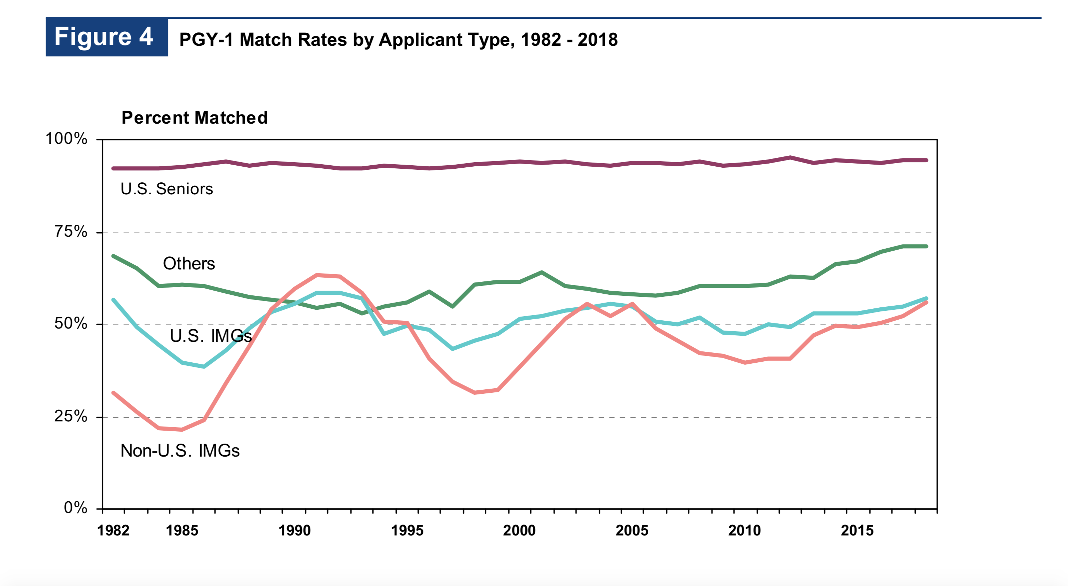

Slide 10
Rules for the Match℠
Rule #1: You can Match℠
Rule #2: We can help
Rule #3: Listen to advice
Rule #4: You don’t know better (Millennials)
Rule #5: Don’t let others interfere
Rule #6: There is a lot of bad advice out there
Rule #7: SOAP℠ is not like being s free agent in the NFL Draft
Rule #8: Rules # 1, 2, 3
Rule #9: Take a deep breath and relax
Rule #10: You can Match℠

Slide 11
https://medschool.vanderbilt.edu/cim/

Slide 14
CV

Slide 15
CV
Curriculum Vitae – “(the) course of (my) life”
What it is
What it isn’t

Slide 16
CV Basics
Chronological order
“It’s all about that date..’bout that date”
Clean & easy to read
Consistency
Perfect
Truthful
Options / Protection / Needed omissions

Slide 17
Common CV Errors
Resume
Dr. Dr.
Period.
Too much
Typoes
Consistency of timeline
Letting go of the past

Slide 18
Vanderbilt: med student (CiM CV):
https://medschool.vanderbilt.edu/cim/cv
Vanderbilt: faculty
https://medschool.vanderbilt.edu/faculty/required-format-curriculum-vitae
Harvard
http://cv.hms.harvard.edu/index.php
Faculty portal:
https://medapps.mc.vanderbilt.edu/facportal/default.aspx

Slide 21
The Interview

Slide 26
Basics
The only part of the application process you can still change
For 2 equally paired applicants, can help tip you over the top – or not
Everyone thinks they know how to do this
Most are wrong
Everything requires practice
Avoid “killing mistakes”
Get immediate feedback and correct errors in performance while you still can

Slide 27
The Process
Faculty (Mentors, FAAs, other faculty)
Schedule date (coming)
Select interviewer
Choose same or different specialty (Vandy interview caveat)
Send in advance via email CV, personal statement, “fact sheet”
Dress for interview and BE ON TIME

Slide 29
Additionally
Don’t have to participate
Interview is private – no information will be shared
Some faculty (and students) may choose NOT to conduct (or have) interview in same specialty if student planning to interview at Vanderbilt – ASK!

Slide 33
Questions?
Michael Pilla, MD
michael.a.pilla@vanderbilt.edu

Slide 34
https://medschool.vanderbilt.edu/cim/

Slide 35
Thank You☺

